Slide 1
Event Spotting in Soccer Games
Guide : Dr.S.Sudha
Team Members : Hari Krishna Nagarajan 2015103017
Sreevatsan Agoramurthy 2015103023
Sribashyam Sriranjan Srinivas 2015103049

Slide 2
INTRODUCTION

Slide 3
Introduction
Difficulty in spotting events in soccer matches –
Duration of the game
Coarse grained nature of the game
Our attempt – Spotting events in videos of soccer matches
‘Spotting’ = Finding anchors of events in soccer videos
Events
Goal Foul Substitution

Slide 4
OBJECTIVES

Slide 5
Objectives
To analyze the video database containing over 500 hours of soccer match footage and ‘spot’ events.
To classify these events , that have been spotted using activity recognition techniques, into three classes, namely:
Substitution
Card
Goal
To develop a model that can perform localization of very-sparse events in long videos and annotate them accordingly.

Slide 6
PROPOSED SYSTEM

Slide 7
Proposed System
We collect the video footage of games and edit them to match our requirements.
We also crawl the internet using APIFootball and get match reports for the corresponding videos.
We then use ResNet instance to generate all the frame features for our videos.
Since the dimensions of the frame feature for each video is very big, we use PCA in order reduce it.
After obtaining the reduced frame features we then feed into a Neural Network along with the annotations of the events and build a model that will learn each event.
We can then use this model to predict the classes.

Slide 8
SYSTEM ARCHITECTURE

Slide 9
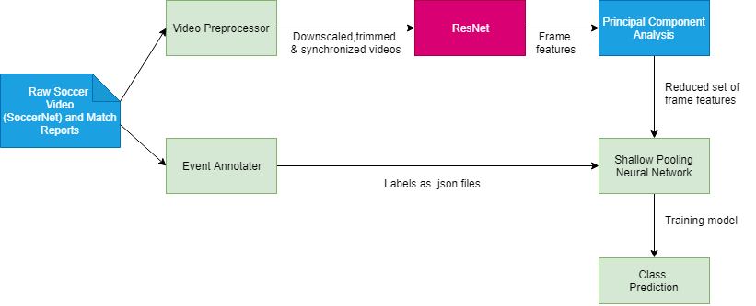
System architecture

Slide 10
MODULE DESCRIPTION

Slide 11
Video Preprocessor
Input: Raw video footage of soccer games
Output: Two 45 min halves of the soccer game in drive
Psuedocode:
Trim the video to 224x224 resolution
Using Adobe Premium Pro, remove the media coverage and replays present in the footage; the timestamp in the video should match with the actual in-game time
Color correct the videos as different soccer leagues have different color schemes and we need uniformity through all the videos
Set the frame rate to 25 frames/second

Slide 12
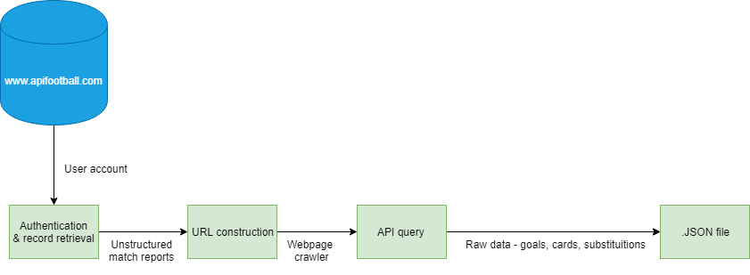
Event Annotator
Input: Python script with API to crawl the web
Output: .JSON files containing event time stamps
Psuedocode:
Register with www.apifootball.com.; get authentication key
API endpoint has following parameters: League ID, Date_from & Date_to, Team_Name
Build the URL using get-record() function (send parameters here)
Query the API to collect the details of the soccer game
Define three separate functions- getcards(), getgoals(), getsubstitutions() in order to seperate only the relevant data

Slide 13
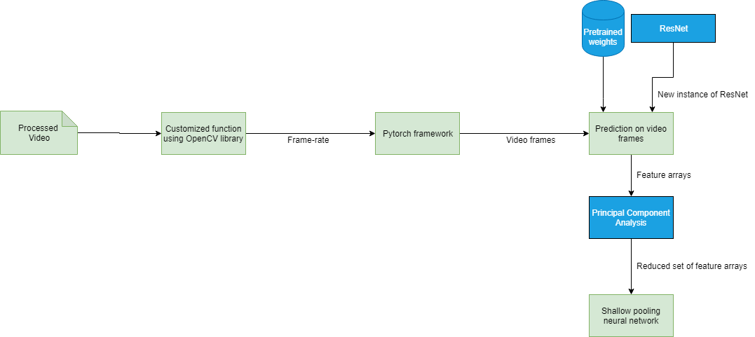
ResNet
Input: 45min video
Output: Frame features for the video
Pseudocode:
We use getFPS() in order to get the FPS of the video
GetVideoFrames() to get the video frame arguments: VideoPath, GameStartIndex, GameEndIndex, Height, Width using the handlers such as OpenCV or SciKit-Learn
The output will be 4D Numpy array per second of a video reading the metadata
Create an instance of ResNet with input as dimensions of video frames and output as the fc1000 layer in ResNet
We choose every 25th frame basically meaning the frame after every second
Using resnet, predict values on the set of the frames
Return feature arrays

Slide 14
Principal Component Analysis
Input: 5.5M feature array
Output: Feature array with reduced dimensionality
Since there are 2048 feature per single frame the number of total frame features are 5.5 million features (2048 frame features * 60 seconds * 45mins)
Therefore we use PCA to reduce the dimension to 512 features

Slide 15
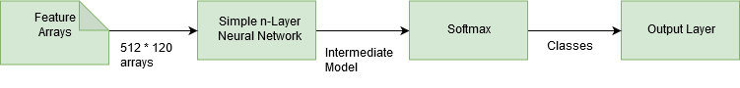
Shallow Pooling Neural Network
Input: Frame features of the video
Output: A model that we can use to predict the type of event
Pseudocode:
Find features which correspond to event times extracted from annotated Match Reports
Feed it through a simple Neural Network with very few layers
Sigmoid Activation Layer, Adam optimizer minimizing binary cross-entropy loss function
Evaluate output using mAP(mean average Precision)

Slide 16
TESTCASES

Slide 17
Testcases
No event occuring : "No event has occurred“
Goal : "Goal“
Substitution : "Substitution“
Duration of video > 2minutes : "Video too long“
Format of video is not .mkv : "Video codec cannot be parsed"

Slide 18
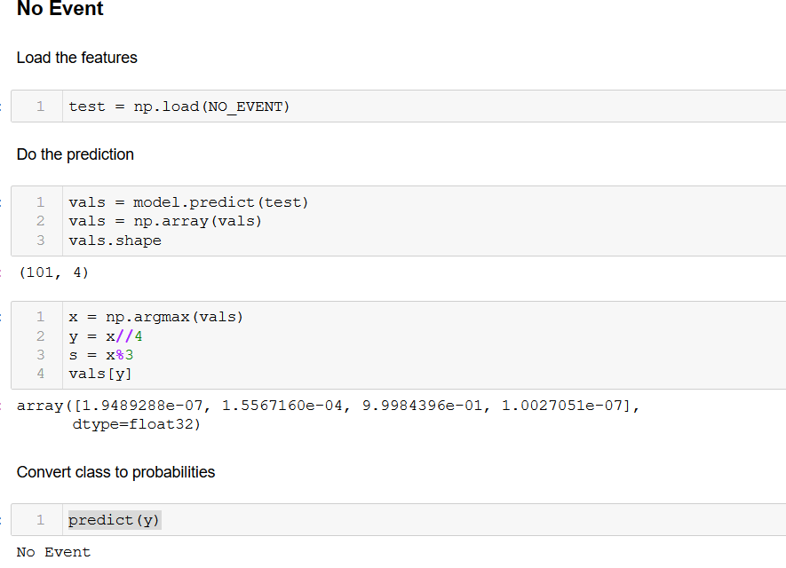
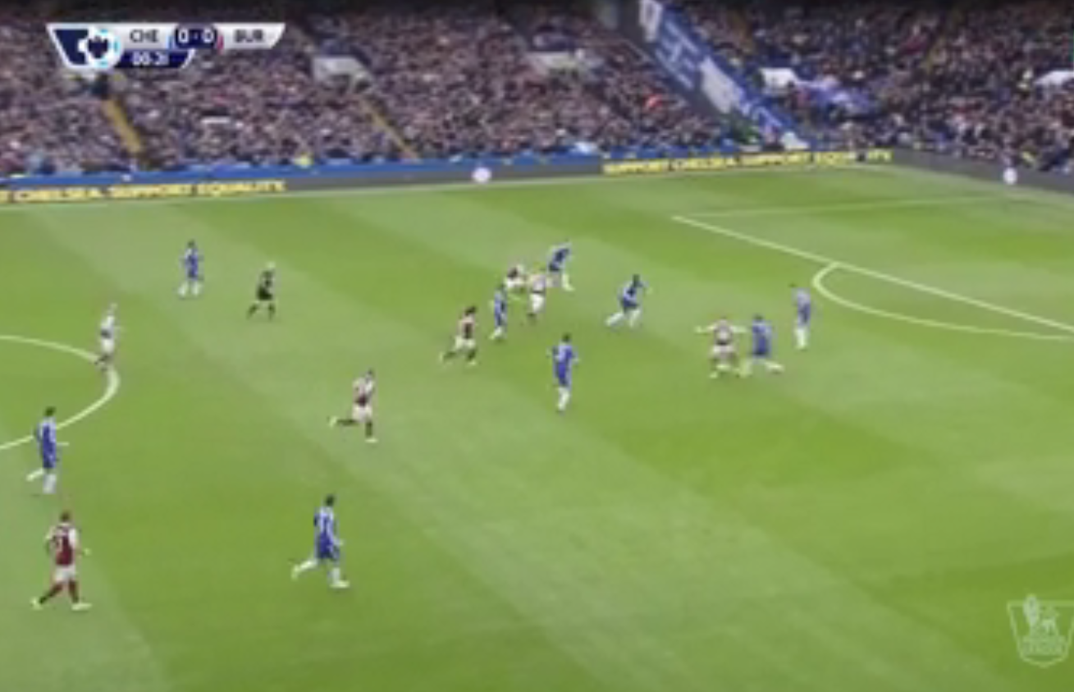
No event occurring
INPUT
OUTPUT

Slide 19
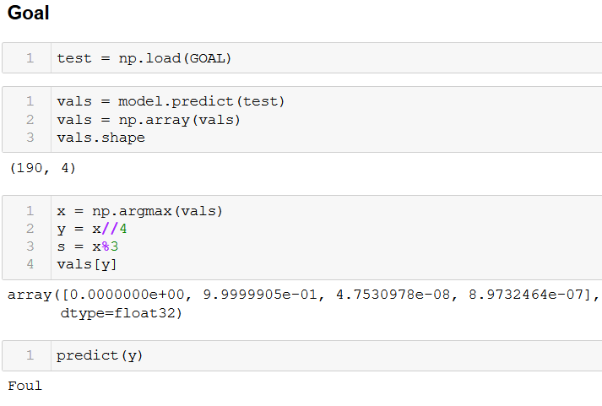
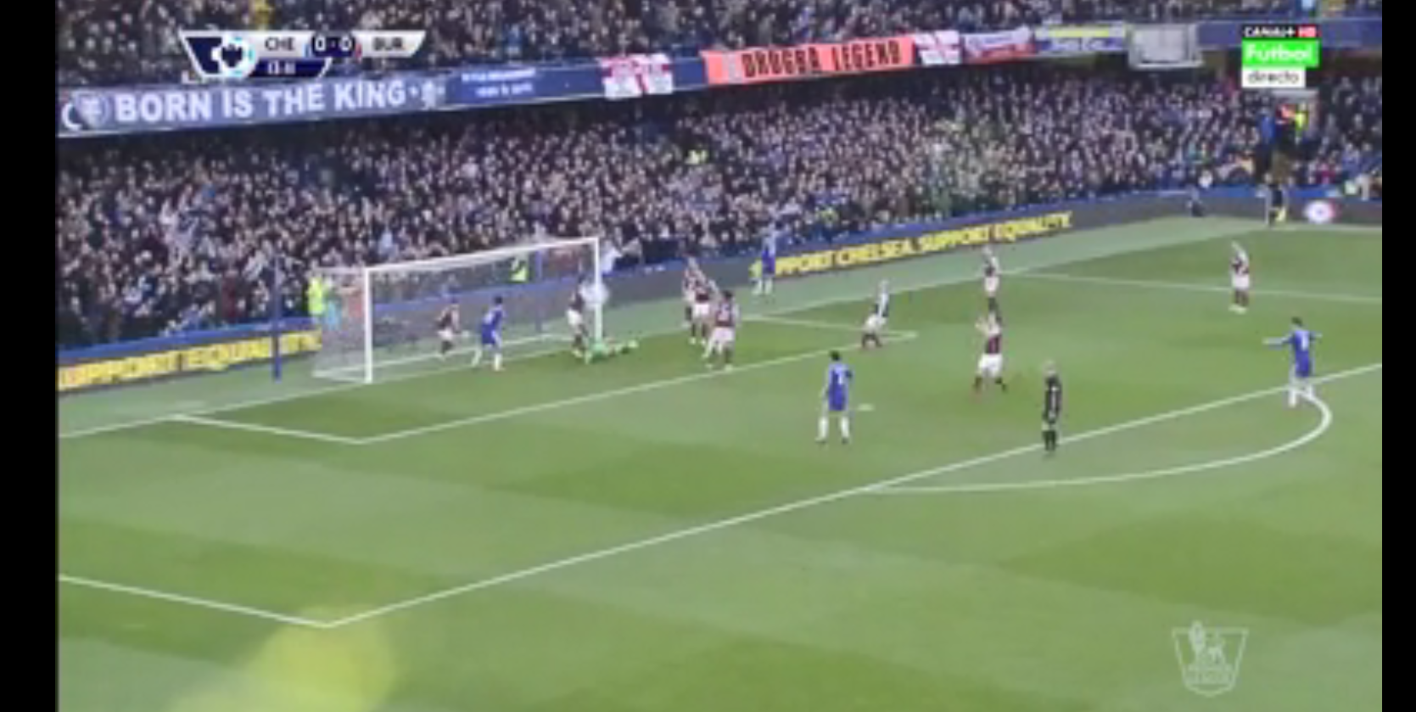
Goal
INPUT
OUTPUT

Slide 20
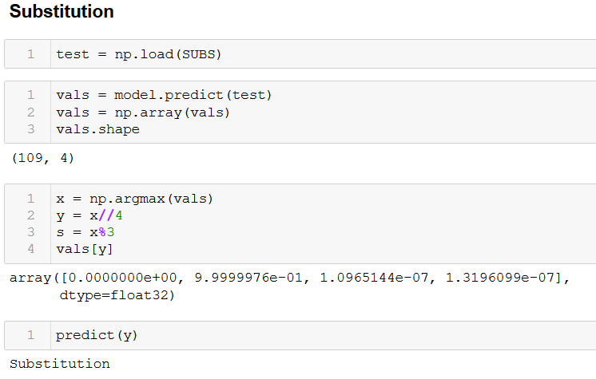
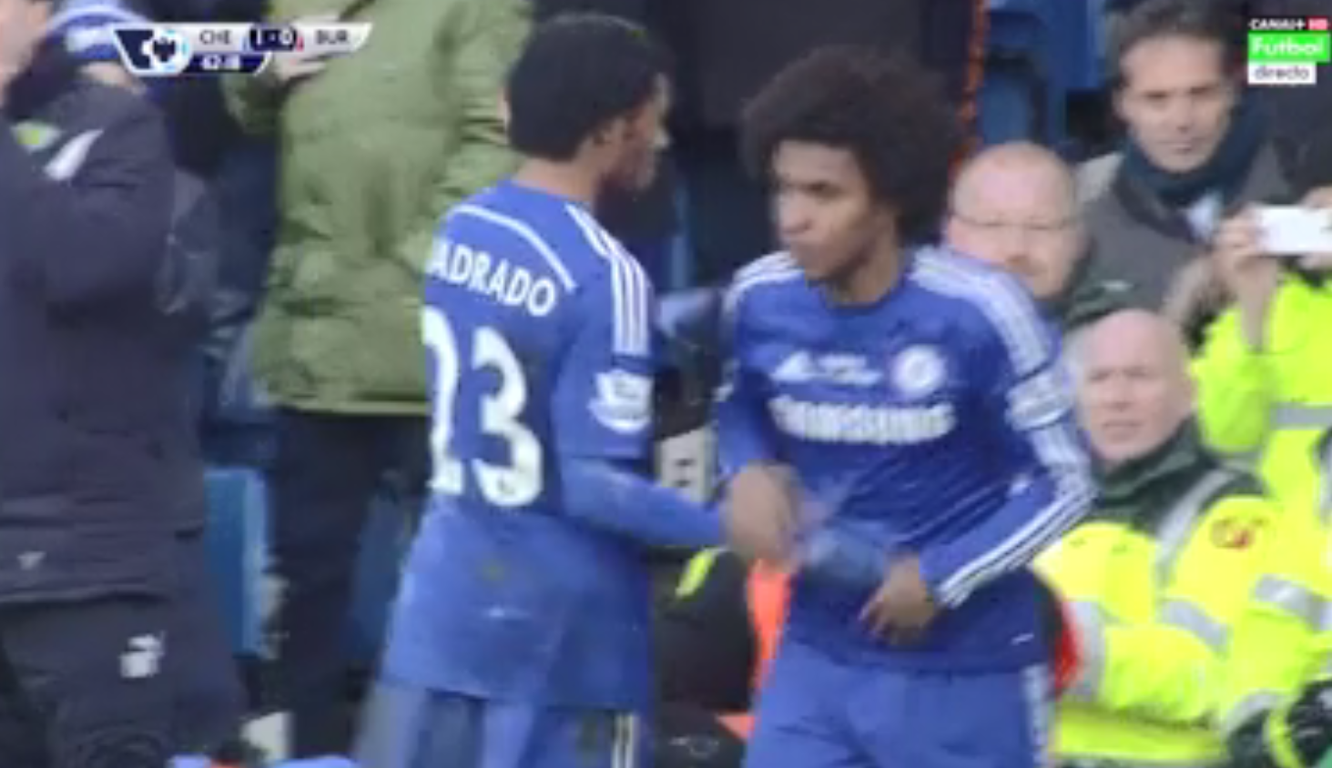
Substitution
INPUT
OUTPUT

Slide 21
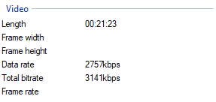
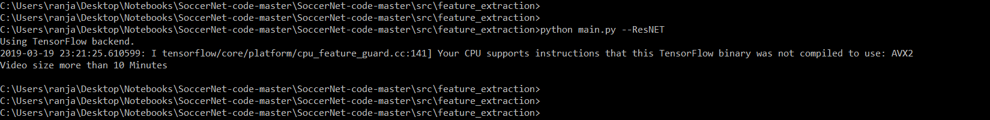
Duration too long ( > 10 minutes )
INPUT
OUTPUT

Slide 22
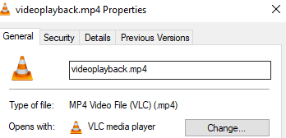
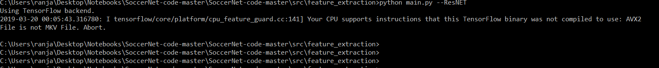
Wrong Codec
INPUT
OUTPUT

Slide 23
PERFORMANCE METRICS & RESULTS

Slide 24
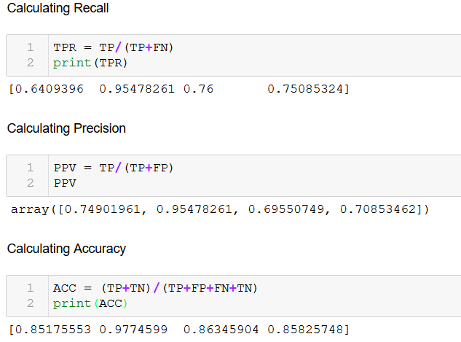
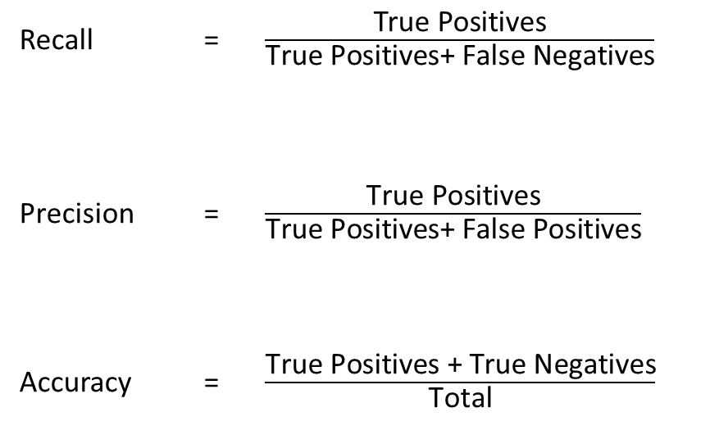
Performance Metrics
For evaluation of our model we calculate the Recall, Precision and mean Average Precision for each class of event identified and also a mean Average Precision over all the classes.
Recall = $\frac{\text{True} \text{Positives}}{\text{True} \text{Positives}\text{+ }\text{False} \text{Negatives}}$
Precision = $\frac{\text{True} \text{Positives}}{\text{True} \text{Positives}\text{+ }\text{False} \text{Positives}}$
Accuracy = $\frac{\text{True} \text{Positives}\text{ + }\text{True} \text{Negatives}}{\text{Total}}$

Slide 25
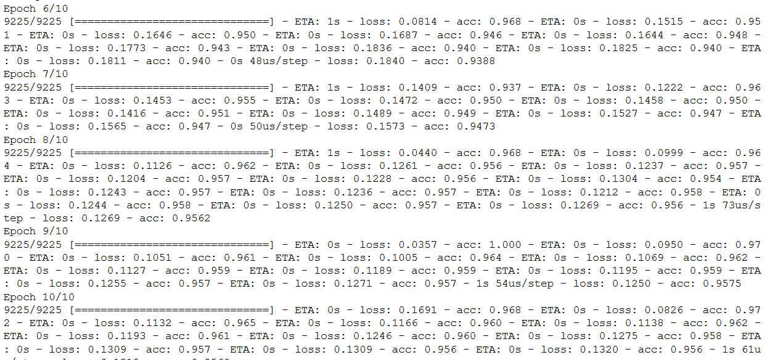
Training Accuracy

Slide 26
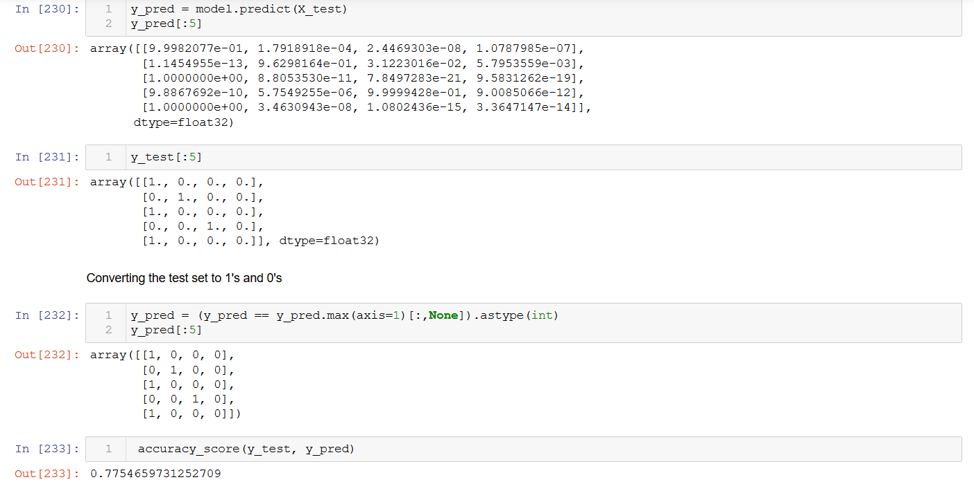
Testing Accuracy

Slide 27
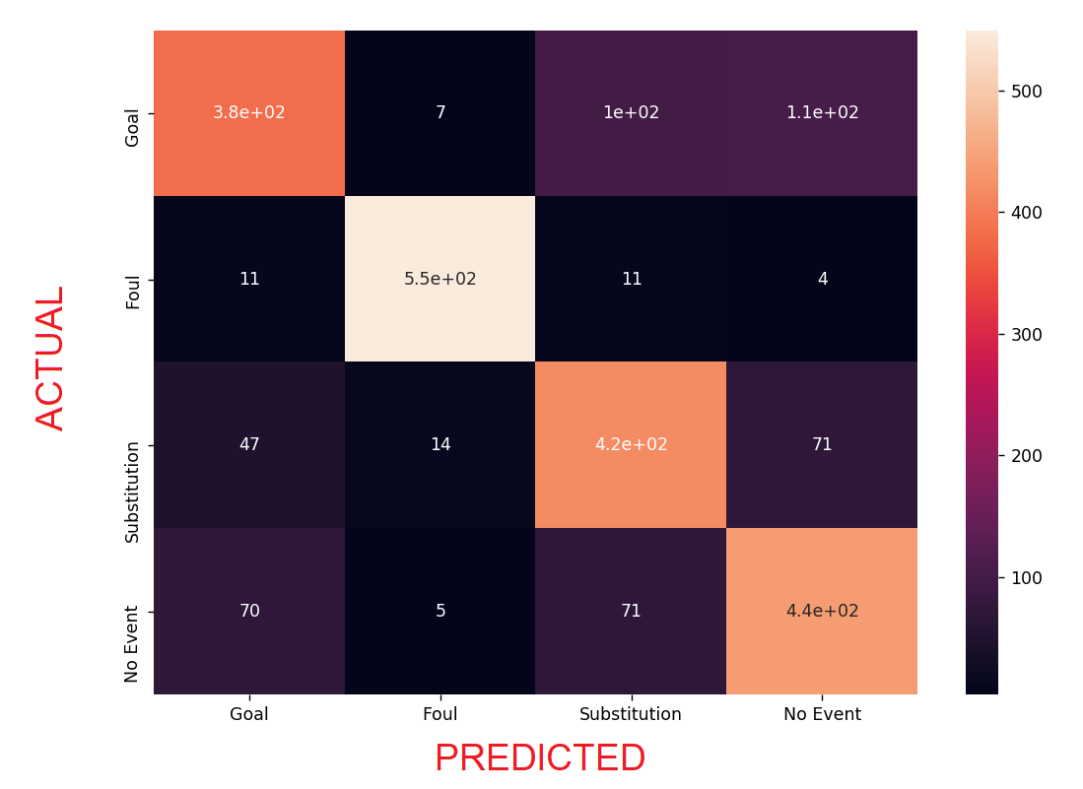
Confusion Matrix
False Negatives

Slide 28
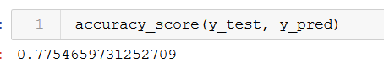
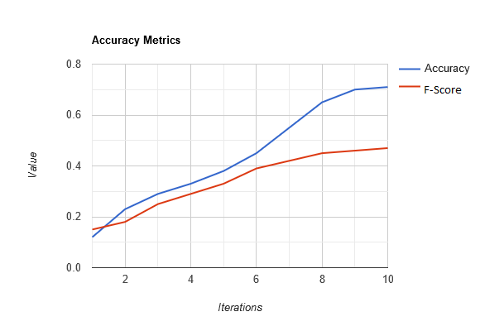
Overall Accuracy

